Slide 1
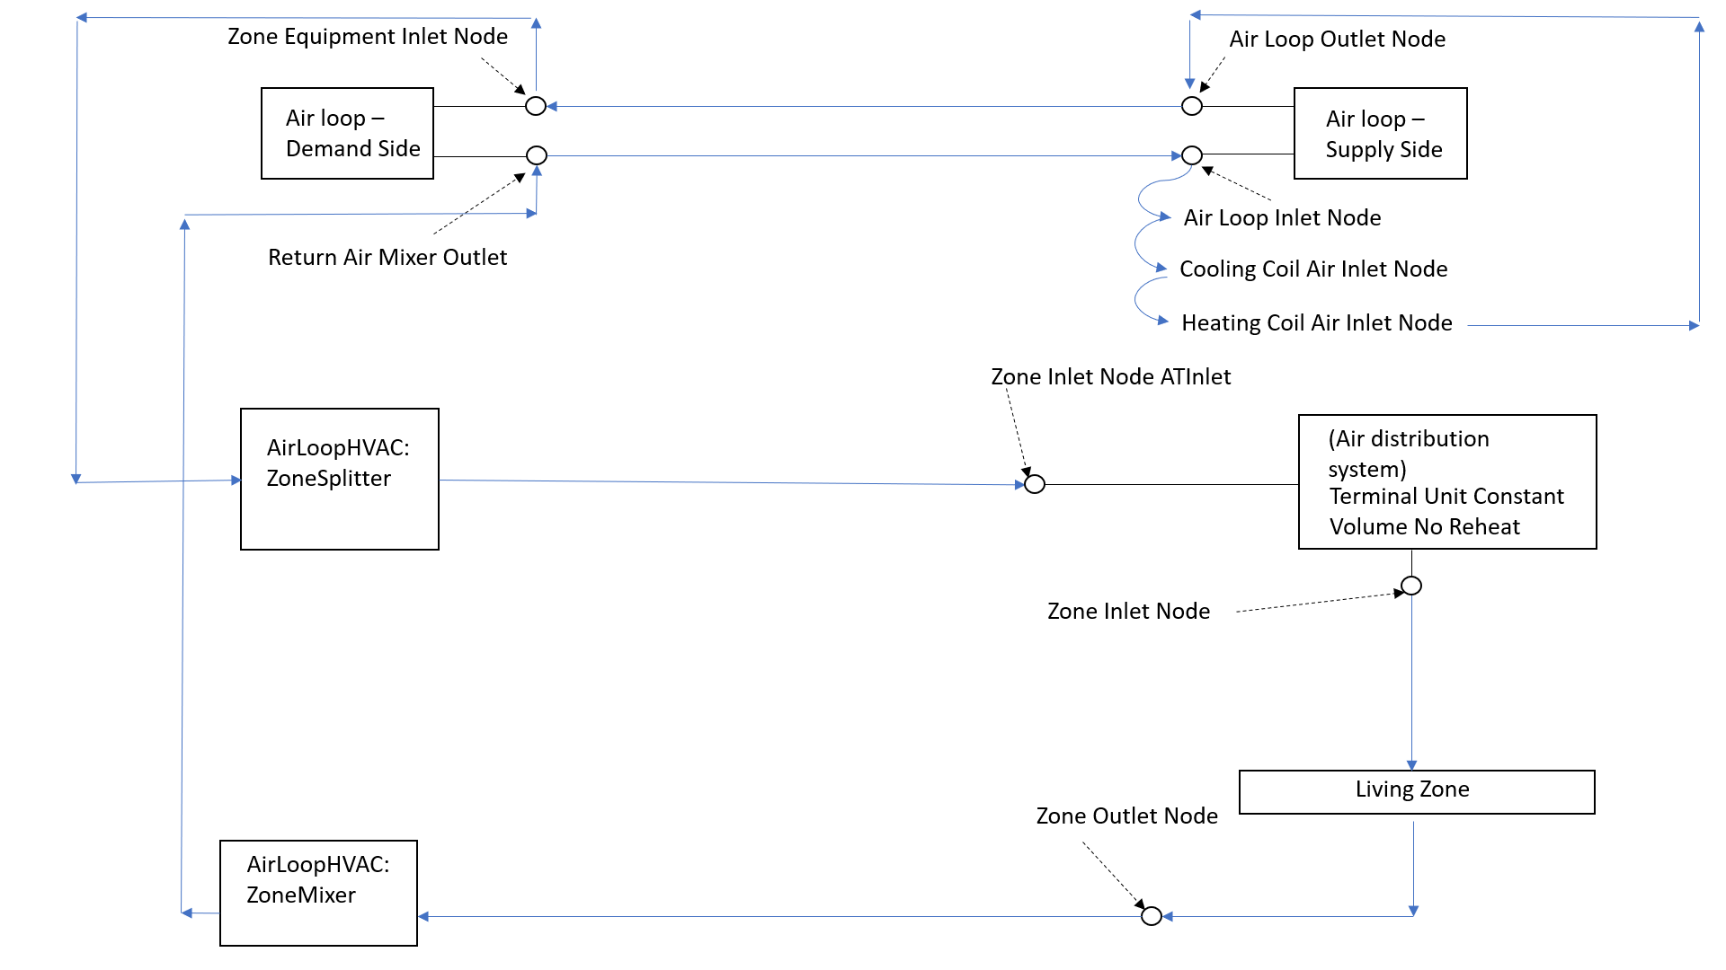
Airloop
Derived from figure available on https://www.linkedin.com/pulse/energyplus-airflow-network-modeling-simple-house-chandan-sharma

Slide 2
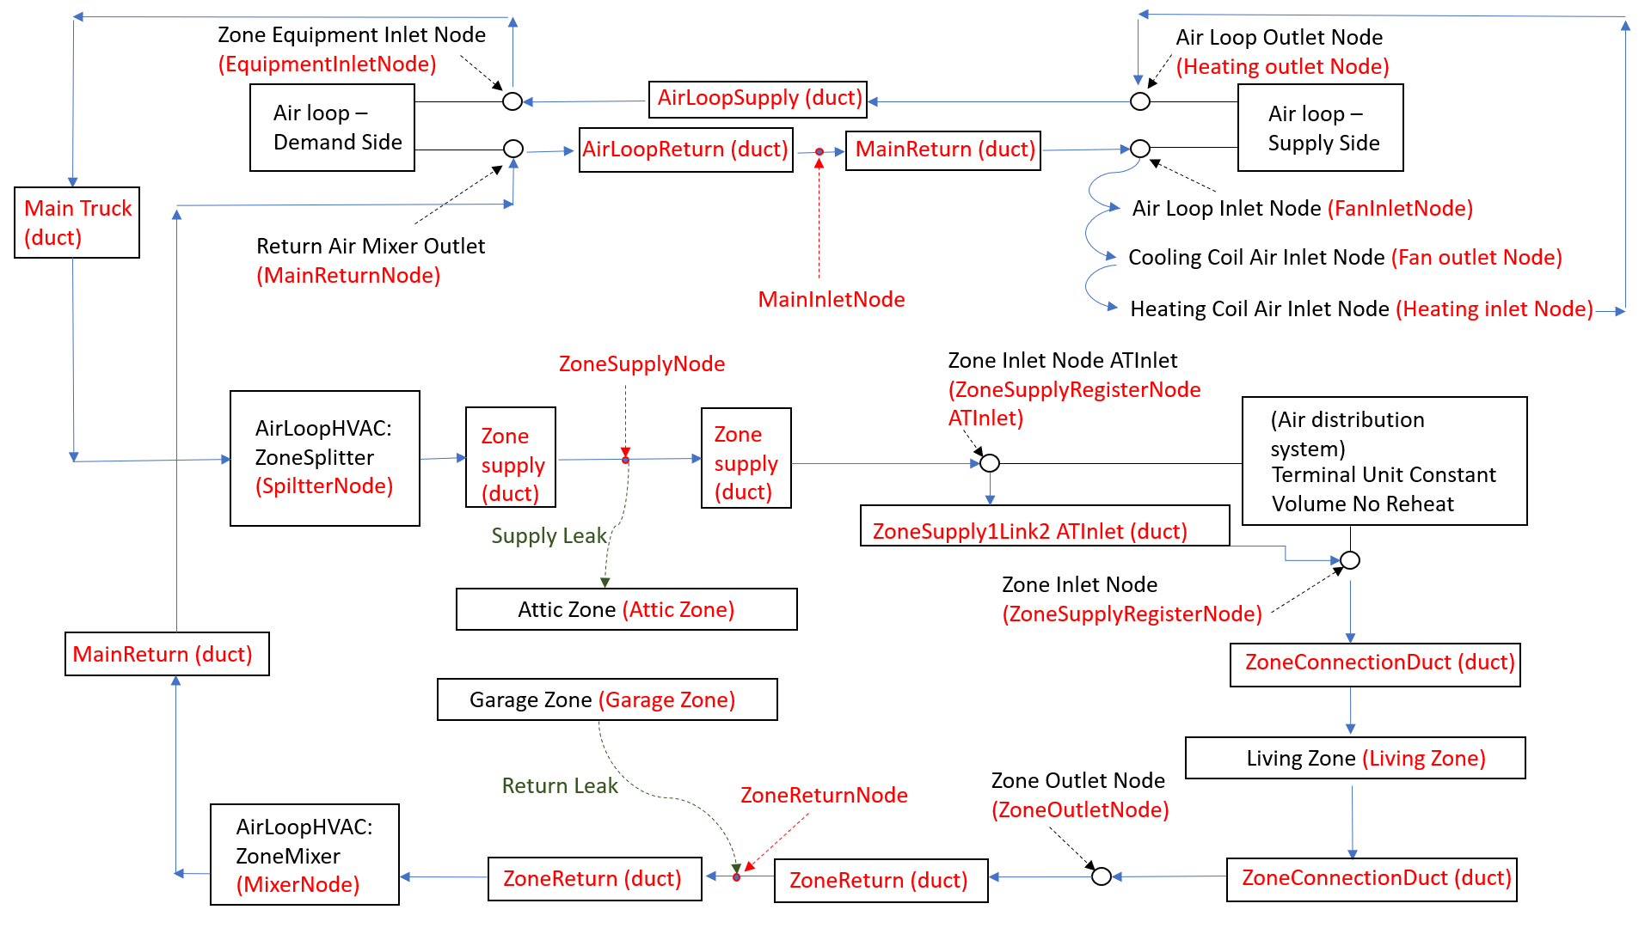
AFN: Crawlspace
MainTrunk (duct)
Supply Fan
Located in Attic Zone
ZoneSupplyLink2 ATInlet Duct
Crawlspace (zone)
Located in Crawl Zone
Located in Living Zone
Derived from figure available on https://www.linkedin.com/pulse/energyplus-airflow-network-modeling-simple-house-chandan-sharma

